Slide 1

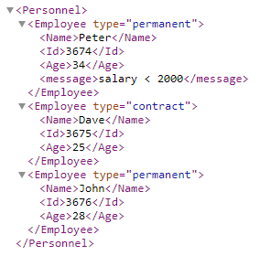
XML Elements
An XML document contains XML Elements.
An element can contain
Text
attributes,
other elements
or a mix of the above
An element with no content is said to be empty.
We can also use a so called self-closing tag
XML Naming Rules
Element names are case-sensitive
Element names must start with a letter or underscore
Element names cannot start with the letters xml (or XML, or Xml, etc)
Element names can contain letters, digits, hyphens, underscores, and periods
Element names cannot contain spaces

Slide 2
XML Elements
Commonly used Naming Styles
Style | Example | Description
Lower case | <firstname> | All letters lower case
Upper case | <FIRSTNAME> | All letters upper case
Underscore | <first_name> | Underscore separates words
Pascal case | <FirstName> | Uppercase first letter in each word
Camel case | <firstName> | Uppercase first letter in each word except the first
Avoid "-". If you name something "first-name", some software may think you want to subtract "name" from "first".
Avoid ".". If you name something "first.name", some software may think that "name" is a property of the object "first".
Avoid ":". Colons are reserved for namespaces (more later).

